Slide 1
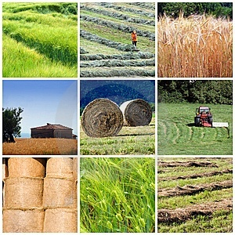
CROP PRODUCTION AND MANAGEMENT

Slide 2
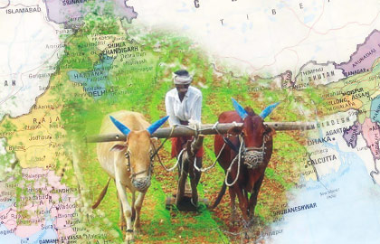
Agriculture
Growing same type of plants together at a place on a large scale is called agriculture. It involves various steps to be undertaken by the farmer

Slide 3
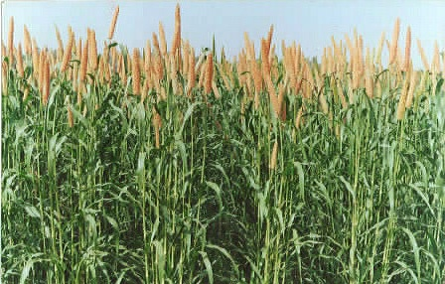
Crops
Plants of same kind grown on a large scale for food, clothing, etc., are called crops.

Slide 4
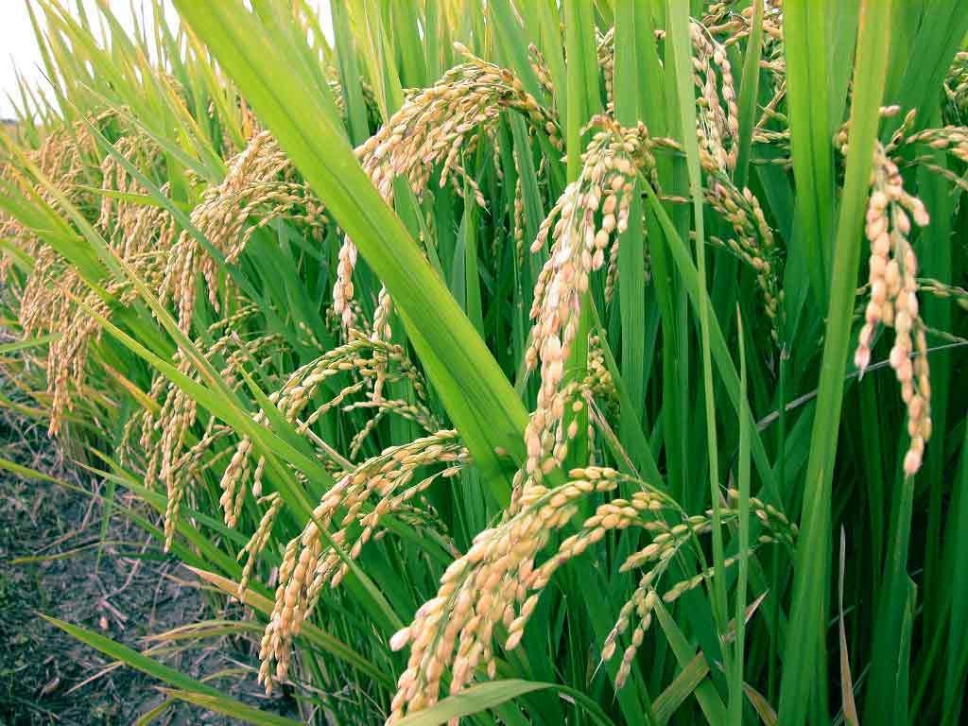
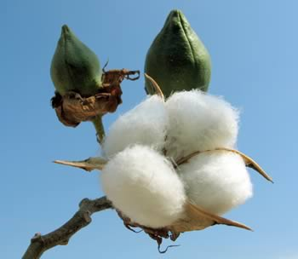
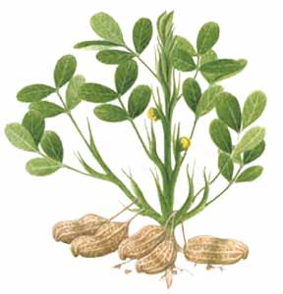
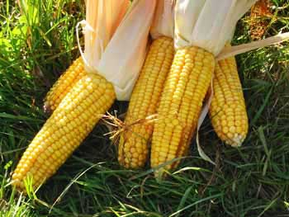
KHARIF CROPS
They are generally planted in June and harvested in October. Rice, maize, cotton and ground nuts are examples of kharif crops.
RICE
COTTON
MAIZE
GROUNDNUT

Slide 5
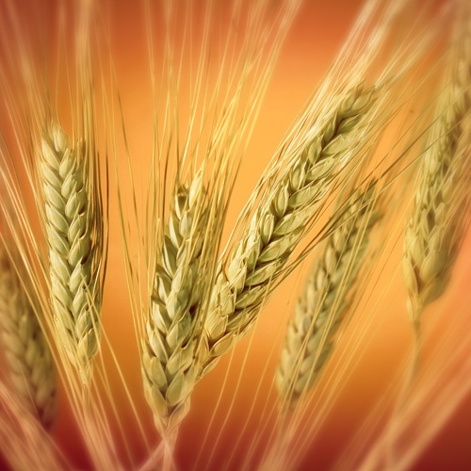
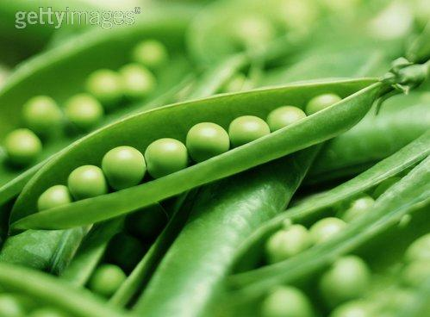
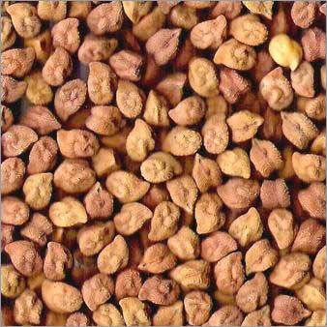
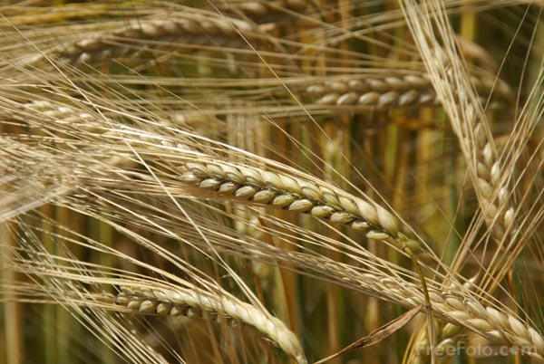
RABI CROPS
They are generally planted in November and harvested in April. Wheat, barley ,pea and gram are examples of rabi crops.
PEA
WHEAT
BARLEY
GRAM

Slide 6
Agricultural practices
1)Soil preparation
a)Ploughing
b)Leveling
2)Selection and sowing of seeds
3) Adding of manure and fertillizers
3)Irrigation (watering of crops)
4)Weeding and crop protection
5)Harvesting
6) Storage

Slide 7
Soil Preparation
Soil preparation involves ploughing , levelling and applying fertilizers. This step readies the soil for crop plantation

Slide 8
Ploughing
The process of loosening and turning
the soil upside down is called ploughing or tilling.

Slide 9
Levelling
Even after ploughing, big
Lumps of soil may remain
In the field . These are crushed using wooden or iron planks called levellers. This process
is called levelling.

Slide 10
Applying Fertilizers
Eventually , the soil even turn infertile. To avoid this situation , farmers often add substance called fertilizers.

Slide 11
Selection Of Seeds
Selecting good-quality, healthy seeds is the next important of crop production. In India, a government body called
The National Seeds Corporation (NSC) is involved in the production of good-quality agricultural seed.
NSC has also helped in setting up seed-testing laboratories in different parts of the country.

Slide 12
Sowing Of Seeds
Sowing is the process of placing seeds in the soil. Sowing may be done manually or with the help of an implement called seed drill.

Slide 13
Manual Sowing
This process involves directly sprinkling seeds ino the soil. Seeds sown in this manner are distributed unevenly, Also, this method may not ensure that all seeds are sown at the correct depth.

Slide 14
Using A Seed Drill
A seed drill ca be pulled across the field using bullocks or a tractor. Seeds sown using a seed drill are distributed evenly and
Placed at the correct depth in the soil.

Slide 15
IRRIGATION

Slide 16
IRRIGATON- It refers to artificial
Application of water to the soil for assisting the growth of crops.
Methods of irrigation may be considered under two broad categories : traditional and modern.

Slide 17
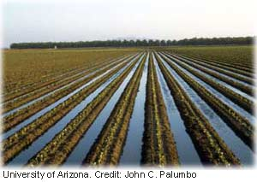
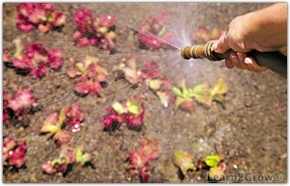
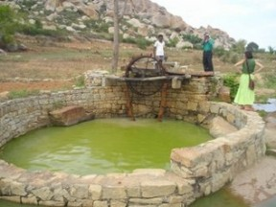
TRADITIONAL METHODS
Canal irrigation , furrow irrigation , chain pump , moat [ pulley system ] , dhekli , rahat [water wheel] are some of the traditional methods of irrigation these method are cheaper , but often lead to wastage of water.

Slide 18
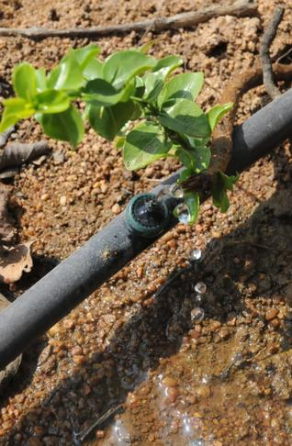
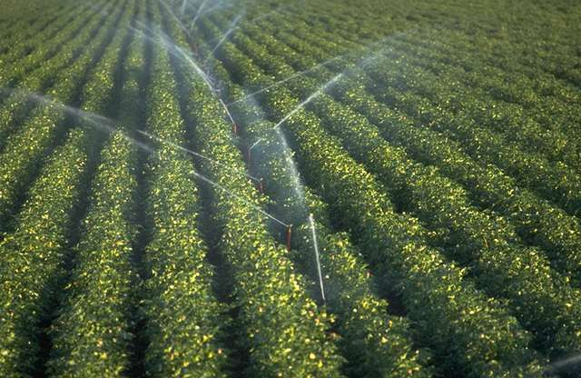
MODERN METHODS
Sprinkler irrigation and drip irrigation are examples of modern methods of irrigation.
These methods help in saving water eg. - sprinkler system and drip irrigation.

Slide 19
WATERLOGGING
Care must be taken not to water the field excessively. Excess water on the field may cause a condition waterlogging.
Decreasing the amount of air available to the roots and
Leading to an increase in the salt content of the soil.

Slide 20
WEEDING
Sometimes , desirable plants called weeds grow along with the crop. Amaranthus [chaulai] wild oat ,grass are examples of weeds.
The process of removing weeds is called wedding. Weeding may be done manually or by using chemicals called weedicides.

Slide 21
STORAGE
Harvested grains need to be stored before they made available for consumption .To prevent their spoilage , it is necessary to insure that both the grains and the storage area are free of moisture .

Slide 22
The storage area should be kept clean and dry .Pesticides should be sprayed beforehand to keep away pests. Periodic inspection of the storage area is necessary to insure the safety of grains

Slide 23
Increasing crop yield
Carrying out the basic agricultural practices systematically can substantially increase crop yield . Techniques such as mixed cultivation and crop rotation can increase crop yield further.

Slide 24
Mixed Cultivation
In mixed cultivation ,two or more different types of crops are sown in a particular field at the same time .For example :- A leguminous plant such as pea can be sown in the same field , along with a cereal such as wheat.

Slide 25
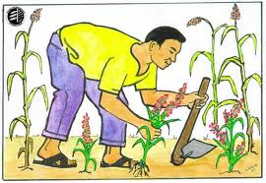
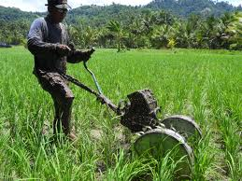
Manual weeding
Weeds may be uprooted by hand or removed with the help of implements such as harrow, trowel, or hoe
manual weeding has the following disadvantages.
it is time – consuming and may even land to accidental removal of desired crops.
the implements used (such as trowel, harrow, and hoe) are made of iron and need regular maintenance to prevent rusting.

Slide 26
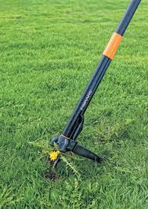
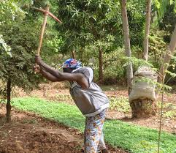
Using weedicides
A weedicide is a chemical that is used to destroy weeds. Weedicides destroy the weeds without affecting the crop. Dalapon, metachlor, and siziazine are examples of weedicides.

Slide 27
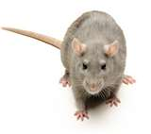
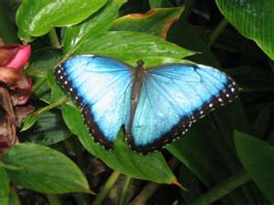
Animals such as rate and insects also damage crops. Such animals are called pests. Pests can be destroyed by using chemicals called pesticides.
Weedicides and pesticides have the following disadvantages.
accidental contact with these chemicals may adversely affect the health of farmers.
Traces of these poisonous chemical may remain in crops themselves, which can be very harmful to human life. It is therefore, very important to wash grains vegetables, etc., thoroughly before consumption.

Slide 28
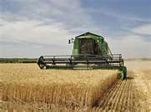
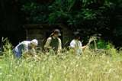
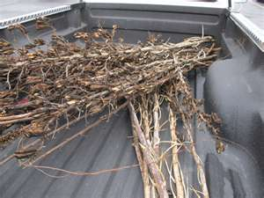
Harvesting
The process of cutting and gathering of called harvesting.

Slide 29
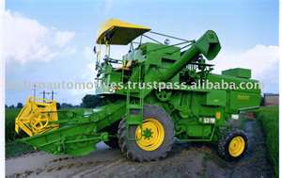
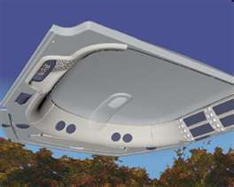
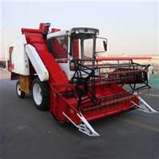
Threshing a machine manually combine harvester can be used for both harvesting and threshing winnowing, which involves the separation of the grain from chaff (seed covering and tiny pieces of leaves or stem), can be done manually, or using a `winnowing machine

Slide 30
Crop Rotation
Changing crop sequences to create an unstable and inhospitable environment for weed establishment and survival –
resource availability allelopathic effects soil disturbance soil fertility mechanical damage
X time

Slide 31
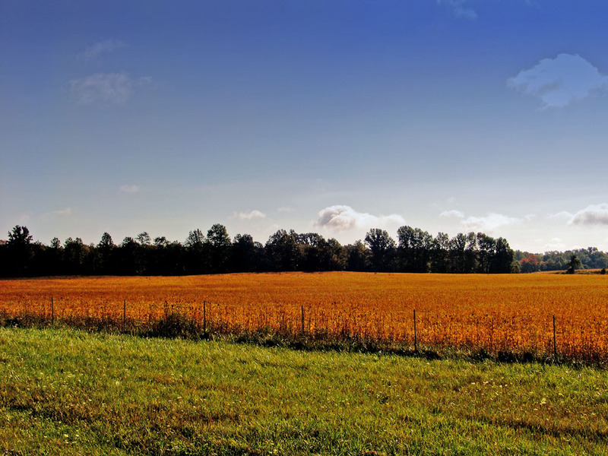
Grass crop
Legume
vegetable
Mustard
Cover crop
Legume
Forage
Small grain

Slide 32
Nitrogen Fixation

Slide 33
Sources
Lightning
Inorganic fertilizers
Nitrogen Fixation
Animal Residues
Crop residues
Organic fertilizers

Slide 34
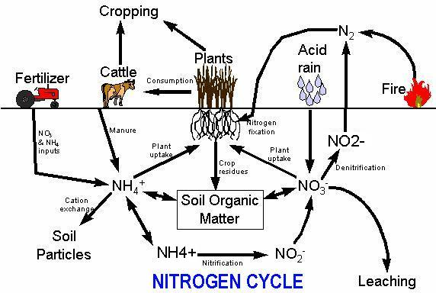

Slide 35
FOOD FROM ANIMALS

Slide 36
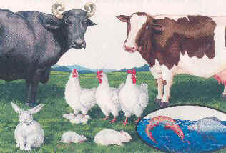
Animal husbandary
We obtain many kind of food item from animals. Rearing animals on large scale, for food and other need.

Slide 37
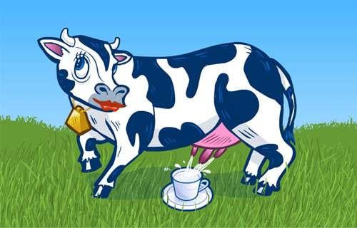
Milk..
Milk is obtained from animals such as cows, Buffalo, and goat. It is used to prepare variety of products such as butter, ghee, cheese and curd,

Slide 38
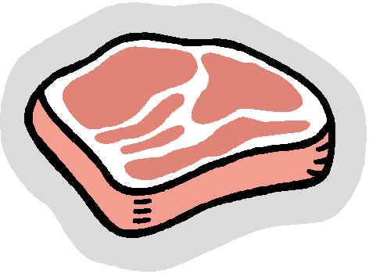
Meat..
Meat is obtained from animals such as goat and chicken. People also eat many kinds of fish, shrimps, lobsters, and other sea animals

Slide 39
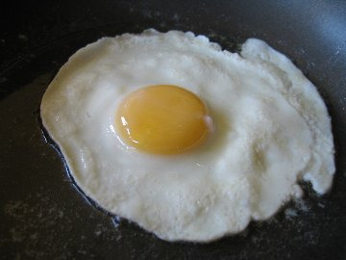
Eggs..
Eggs are obtained from birds such as chicken, turkey, and goose.

Slide 40
Honey..
Honey is obtained from honey bees. The practice of rearing honeybees for honey is known as apiculture.

Slide 41
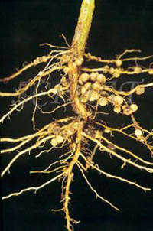
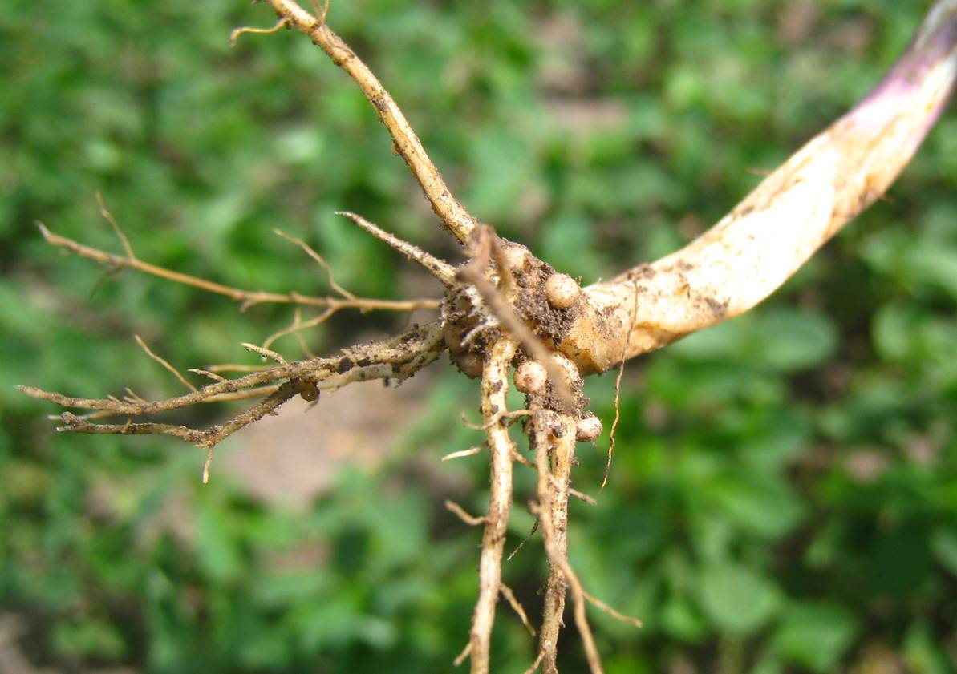
Root nodules of soya..

Slide 42
THANK YOU

